Slide 1


YOU LOOK ONLY ONCE (YOLO) A Hands-on Introduction to the State of the Art Realtime Object Detection Deep Learning Model
Bradley Erickson
MD PhD
Pouria Rouzrokh MD MPH MHPE
Radiology Informatics Laboratory Mayo Clinic

Slide 2
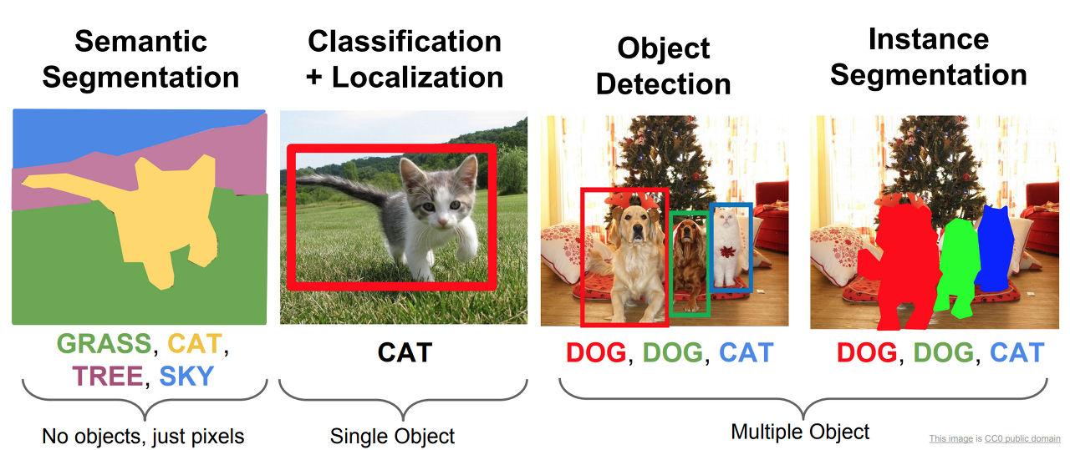
Defining Object Detection

Slide 3
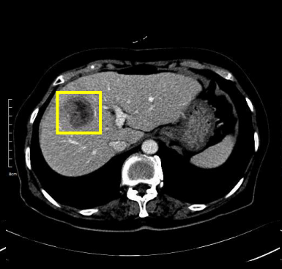
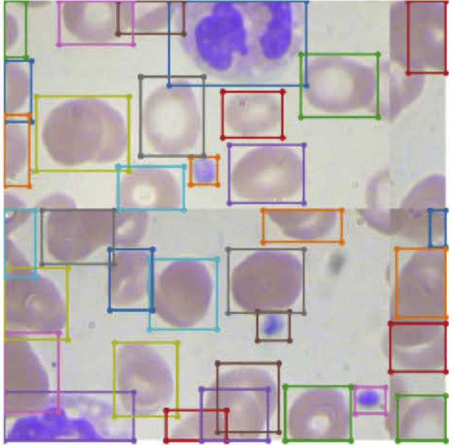
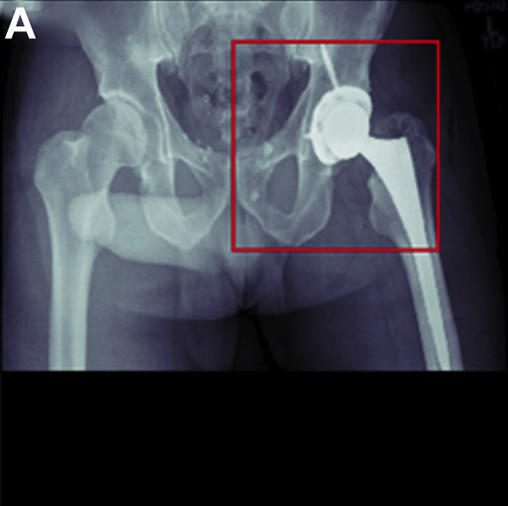
Medical Applications of Object Detection
Sources:
Liver Lesion Detection from Weakly-labeled Multi-phase CT Volumes with a Grouped Single Shot MultiBox Detector
Improved detection performance in blood cell count by an attention-guided deep learning method
Deep Learning Artificial Intelligence Model for Assessment of Hip Dislocation Risk Following Primary Total Hip Arthroplasty From Postoperative Radiographs

Slide 4
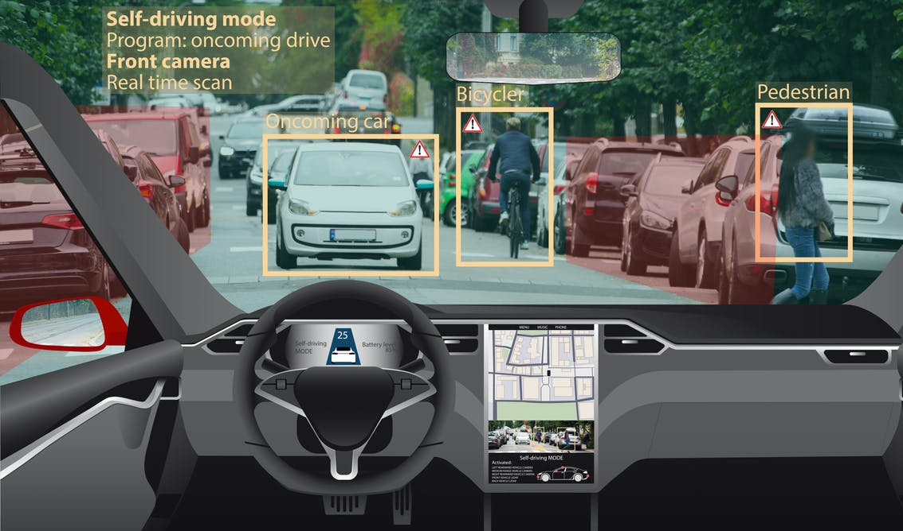
Realtime Object Detection
Real-time object detection is the task of doing object detection in real-time with fast inference while maintaining a base level of accuracy.
The model should be able to detect objects and make inferences within microseconds!
Examples of Real-time Object Detection Models
Faster-RCNN (as opposed to RCNN and Fast-RCNN)
EfficientDet
MM-Detection
Single Shot Detection (SSD)
You Look Only Once (YOLO)
Source: https://theconversation.com/whos-to-blame-when-a-self-driving-car-has-an-accident-150941

Slide 5
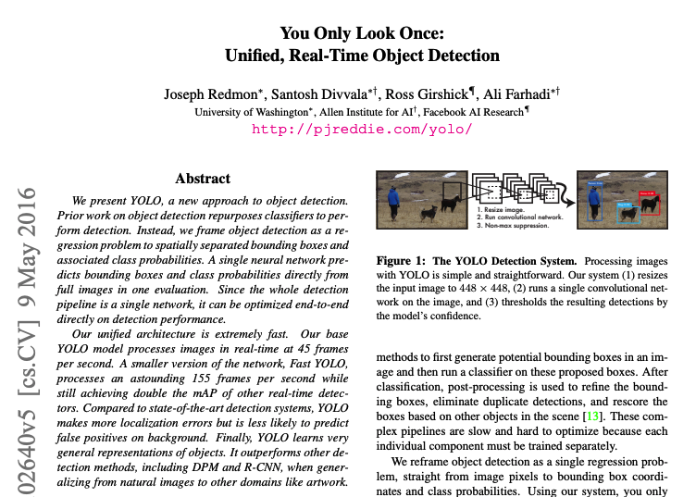
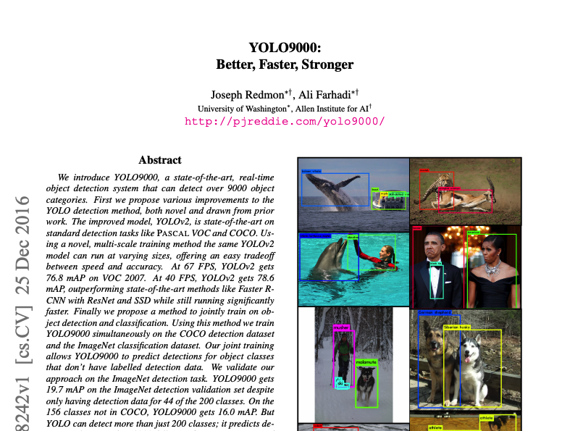
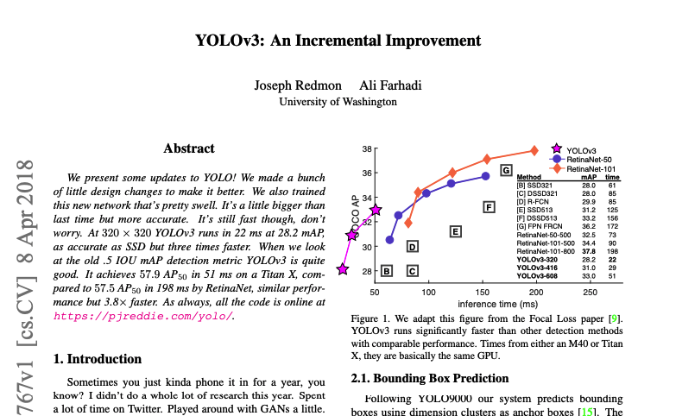
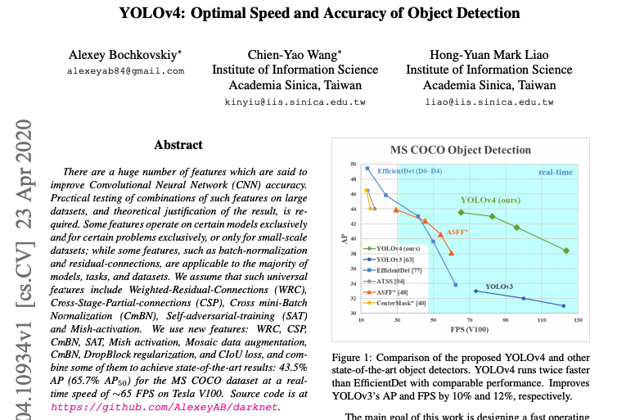
You Look Only Once (YOLO)

Slide 6
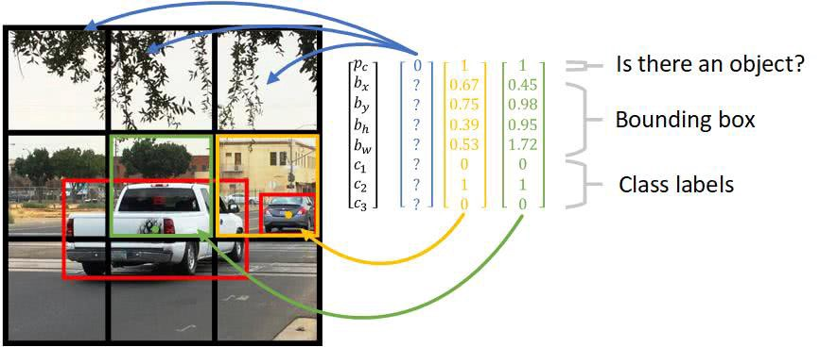
How YOLO works (1)
Source:
https://stackoverflow.com/questions/50575301/yolo-object-detection-how-does-the-algorithm-predict-bounding-boxes-larger-than

Slide 7
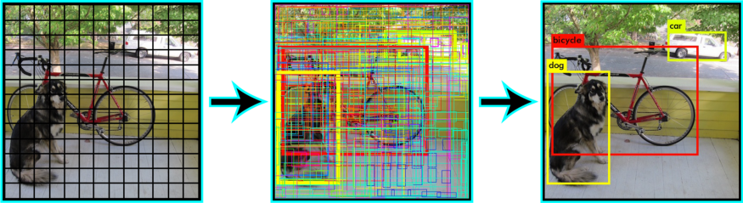
How YOLO works (2)
Non-Max Suppression:
To select the best bounding box, from the multiple predicted bounding boxes, these object detection algorithms use non-max suppression. This technique is used to “suppress” the less likely bounding boxes and keep only the best one.
Source: https://www.pyimagesearch.com/2018/11/12/yolo-object-detection-with-opencv/

Slide 8
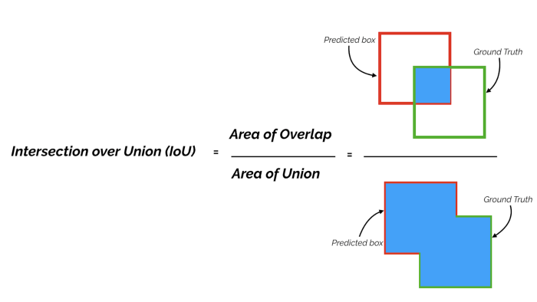
How YOLO works (3)
Source: https://towardsdatascience.com/map-mean-average-precision-might-confuse-you-5956f1bfa9e2

Slide 9
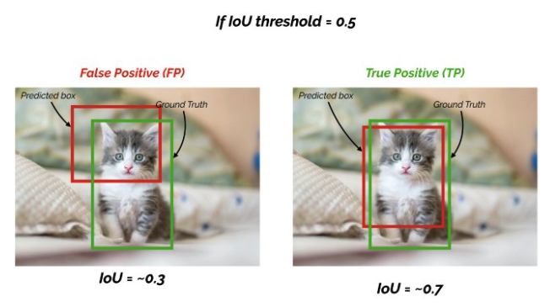
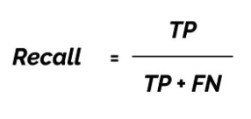
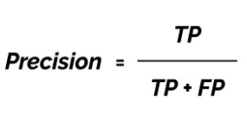
How YOLO works (4)
Mean Average Precision (mAP):
For object detection tasks, we calculate Precision and Recall using IoU value for a given IoU threshold.
The general definition for the Average Precision (AP) is finding the area under the precision-recall curve above.
The mean Average Precision or mAP score is calculated by taking the mean AP over all classes and/or overall IoU thresholds, depending on different detection challenges that exist.
mAP is usually used as the standard metric for evaluating the performance of object detection models.
Source: https://towardsdatascience.com/map-mean-average-precision-might-confuse-you-5956f1bfa9e2

Slide 10
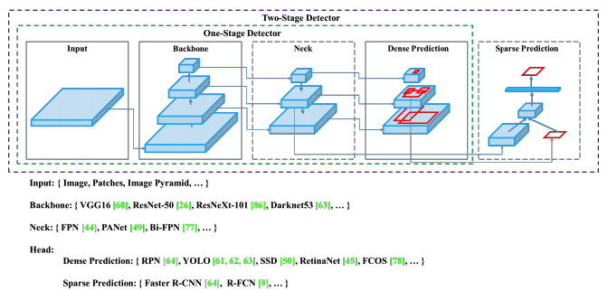
Features of Modern YOLO Models (1)
Source: YOLOv4: Optimal Speed and Accuracy of Object Detection

Slide 11
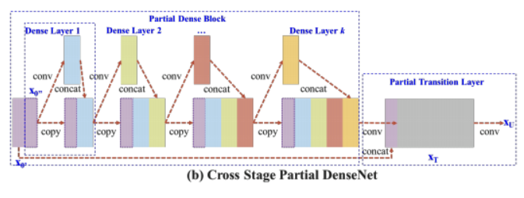
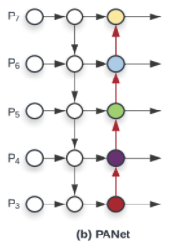
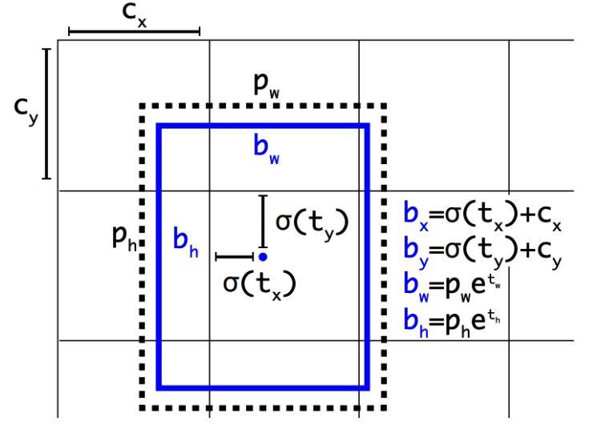
Features of Modern YOLO Models (2)
Use CSPDarknet53 as their backbone.
Use PANet as the neck.
Use Anchor-based detection on Head.
Use Bag-of-Freebies techniques to improve data augmentation.
Mosaic augmentation
Self-adversarial augmentation
Use Bag-of-Specials techniques to increase the performance.
Mish activation function
DropBlock regularization
Source: YOLOv4: Optimal Speed and Accuracy of Object Detection

Slide 12
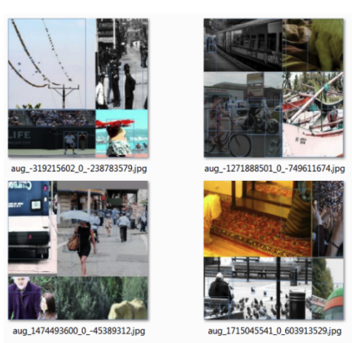
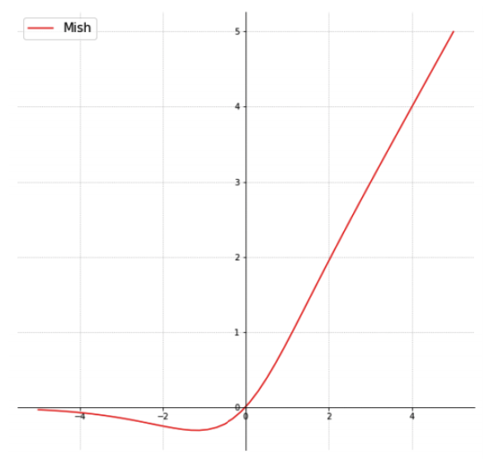
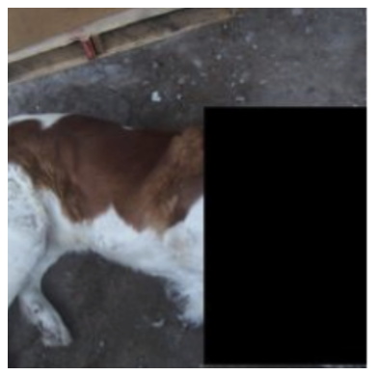
Features of Modern YOLO Models (3)
Mosaic augmentation
Mish activation function
DropBlock regularization
Source: YOLOv4: Optimal Speed and Accuracy of Object Detection

Slide 13

More Words on YOLOv5
One of the latest versions of YOLO.
No scientific manuscript released yet.
Based on YOLOv4 + some technical improvements (e.g., learnable bounding boxes).
Widely used in object detection tasks.
Based on Pytorch (as opposed to Darknet), and therefore significantly smaller than YOLOv4.
Easy implementation for custom training and helpful documentation/ tutorials by Ultralytics.
Different variants (small, medium, large) with different number of parameters available.

Slide 14
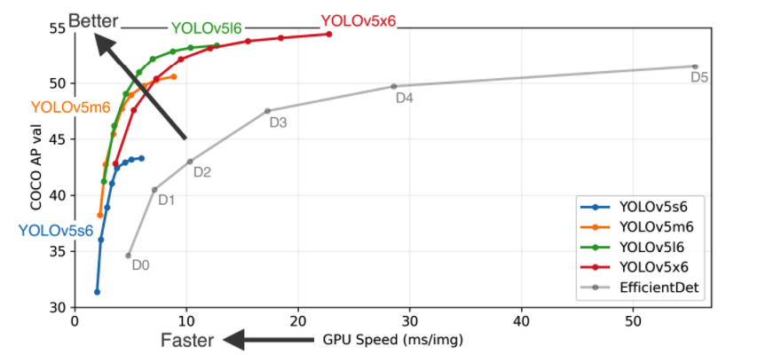
YOLOv5 Performance
Source: https://github.com/ultralytics/yolov5

Slide 15
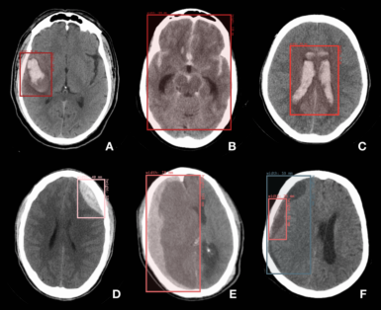
What we do today!
To train a YOLOv5 deep learning model to
detect brain hemorrhage lesion on Head CT scans!

Slide 16
Thank you for your attention!

